Slide 1

Working with Families
พ.ท. หญิง ผศ. พัฒน์ศรี ศรีสุวรรณ

Slide 2
Objectives
To realize importance of family
To develop holistic assessment for family
To develop comprehensive plan for family

Slide 3

Topics
Introduction
Assessment
Management
Take home messages

Slide 4
Definition of family
Any group of persons - related biologically, emotionally, or legally
A group of people – often but not necessary related by blood or marriage – with a commitment to live with and care for one another over time
Christie-Seely J.Working with the family in primary care 1984.

Slide 5
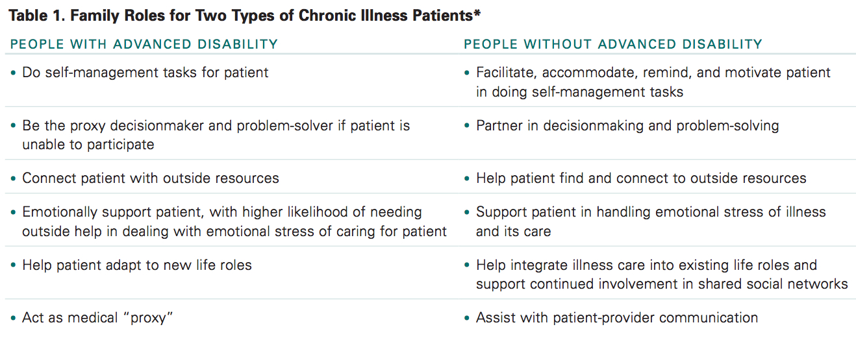
California Health Care foundation 2009.

Slide 6

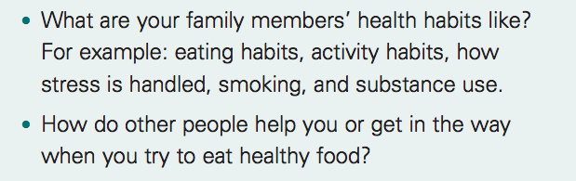

California Health Care foundation 2009.

Slide 7
Family system theory
Interaction of the Individual within the Family
Social Context of the Family
Psychosocial demands of the Illness

Slide 8
Assessment
Family
Anatomy
Development
Function

Slide 9
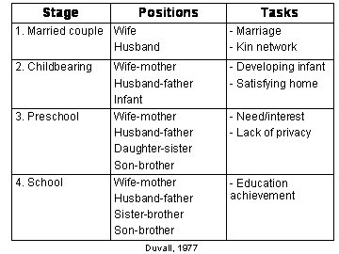
2 years
2.5 years
3.5 years
7 years

Slide 10
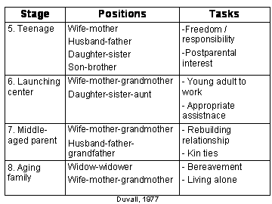
The Family Life Cycle
Married couple
Childbearing
Preschool-age
School-age
Teenage
Launching center
Middle-aged parents
Aging family members
7 years
8 years
15 + years
15 + years
Duvall, 1977

Slide 11
Family structure
1. Hierarchy
2. Boundaries
3. Role selection
-Breadwinner
-Nurturer
-Scapegoat
-Parentified Child
4. Alliance
5. Coalition
McDaniel SH, et al. Family-Oriented Primary Care. 2005:28-2.

Slide 12
Family process
1. Enmeshment
2. Disengagement
3. Triangulation
McDaniel SH, et al. Family-OrientedPrimary Care. 2005:28-2.

Slide 13
Alliance
Coalition
Triangulation

Slide 14
PRACTICE
(McGill Family Assessment Form)
P = Presenting problem
R = Roles
A = Affect
C = Communication patterns
T = Time in family life cycle
I = Illness history
C = Coping with stress
E = Ecology and culture
Barrier et al 1984.

Slide 15
Time flow family chart
หยุดยา
ข้ออักเสบ
กินยา
ขาดยา
ข้ออักเสบ
ผู้ป่วย
มึนหัว
ปวดหัว
อ่อนเพลีย
ภรรยา
โดนไล่ออก
ลูกชาย
URI
URI
URI
URI
URI
หลาน
ม.ค.
ก.พ.
มี.ค.
เม.ย.
พ.ค.
มิ.ย.
ก.ค.
ส.ค.
2556

Slide 16
Family unit
Family census
Family orientation
  Family life cycle
    Stage
  Family as a system
    Member
    Role
    Involve with patient

Slide 17
Helping Families Cope
Provide education
Help remove blame & accept unacceptable feeling
Normalize common family response to illness
Family’s involvement: negotiations
Balance demands & needs
Connections with others
Referral
McDaniel SH, et al. The Developmental Challenges of Chronic Illness. 2005:304-325.

Slide 18
Common pitfalls
Assuming personal responsibility for changing the family
Working alone, neglecting the assistance of the family
Becoming a ‘rescuer’
Murtagh’s general practice. 4th ed. 2007:8-14.
Bennett HD, et al. Fam Pract Manag 2010.

Slide 19
Solutions to avoid pitfalls
Let the patients do the work
Ensure the goals are realistic
Point out all family members have to work together
Identify any tendency to look for scapegoats
Murtagh’s general practice. 4th ed. 2007:8-14.

Slide 20
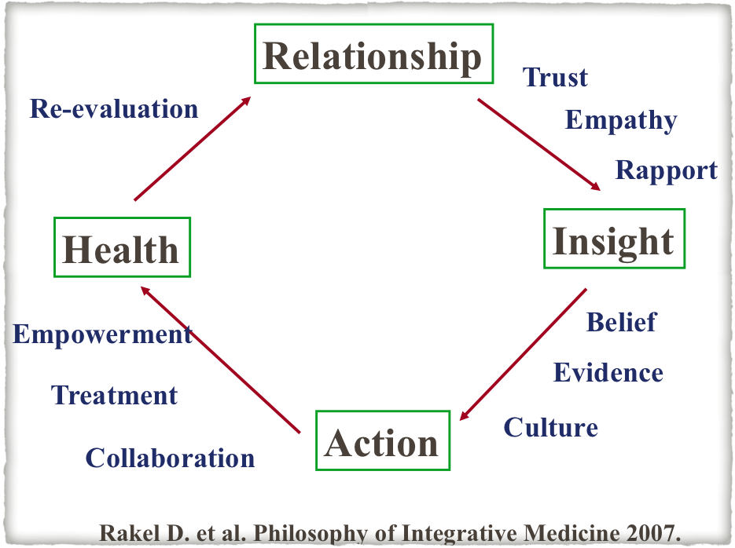

Slide 22
Caregiver Assessment
values
percep
tion
context
well-being
conse
quence
Skill knowledge
resources
Collins LG, et al. Am Fam Physician 2011.

Slide 23
Care of Caregivers
Care
Affection
Rest
Empathy
Goal of care
Information
Ventilation
Empowerment
Resource

Slide 24
References
McWhinney IR. The Family in Health and Disease. A textbook of family medicine. 3rd ed. New York: Oxford University Press, 2009:217-48.
McDaniel SH, Campell TL, Hepworth J, Lorenz A. Family-Oriented Primary Care. 2nd ed. New York: Springer, 2005:28-2.
Campbell TL, Bray JH. The Family’s Influence on Health. In Rakel RE(Ed.), Textbook of family practice. 7th ed. Philadelphia:Saunders, 2007:25-34.
Rakel RE, Rogers JC. The Family Genogram. In Rakel RE(Ed.), Textbook of family practice. 6th ed. Philadelphia: W.B.Saunders, 2002:19-30.
Rainsford GL, Schuman SH. The family in crisis. JAMA 1981;246(1):60-3.
Christie-Seeley J: Working With the Family in Primary Care. New York: Praeger, 1984.
Doherty WJ, Baird MA. Developmental levels in family-centered medical care. Fam Med 1986;18(3):153-56.
Murtagh J.The family. Murtagh’s general practice. 4th ed. Australia:McGraw Hill. 2007:8-14.
Omole F, Sow CM, Fresh E, Babalola D, Strothers H. Interacting with Patients’ Family Members During the Office Visit. Am Fam Physician 2011;84(7):780-784.

